Slide 1
Sean Koppenhafer, Jaime Rodriguez,
Chad Thueson, Noah Erickson, Rishal Dass
Weekly meeting, 05/13/2015
Digital Dash
Portland State University
Department of Electrical and Computer Engineering (ECE)
Notes:
1
1

Slide 2
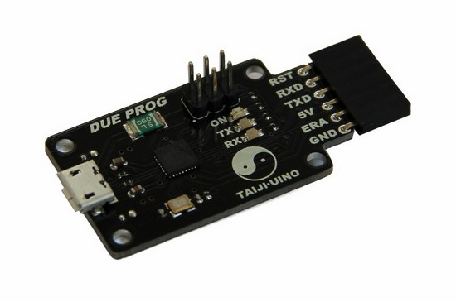
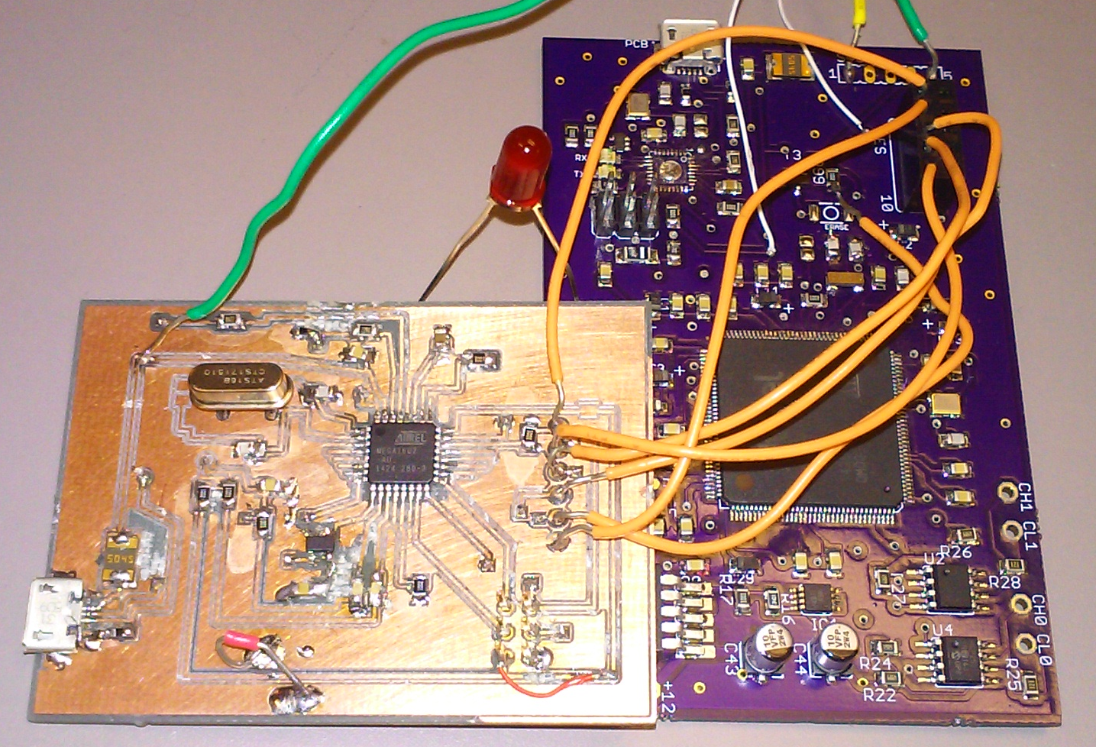
Custom Board Debug
Programming board came in
Also debug board has been created
We have made progress on debugging
we can now recognize the board as a due, but programming is still failing

Slide 3
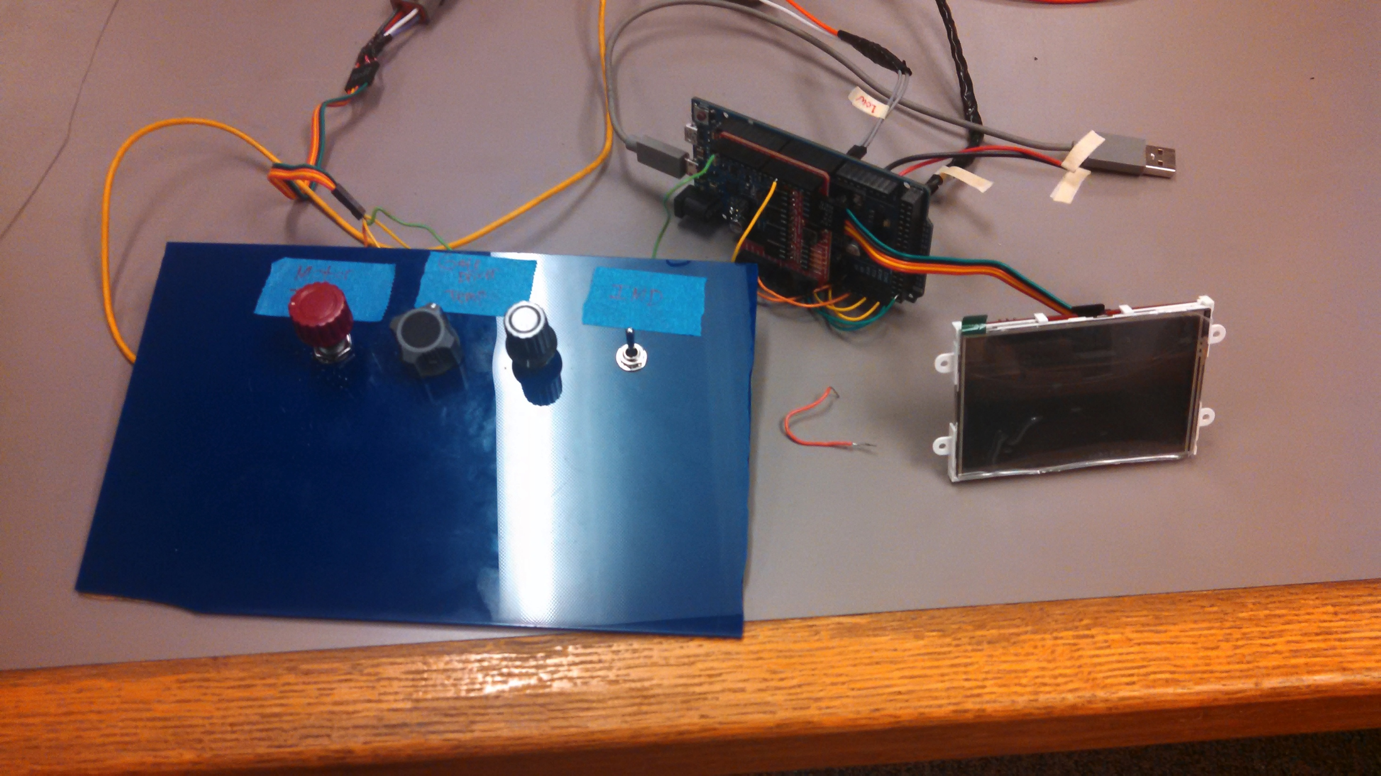
Demo Unit Updates
The battery gauge now works on the screen and in the demo.
Also have motor torque, gate driver temperature and IMD now work.
Prototype is now ready to be put together for demonstration

Slide 4
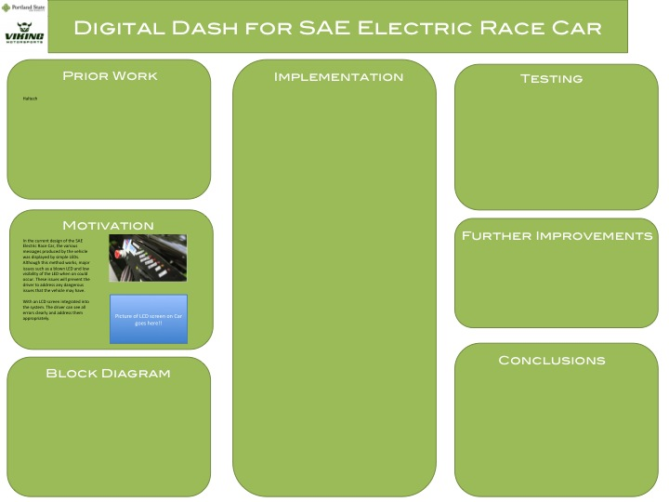
Report and Poster
Presentation date set for June 10, 1pm
Poster is still a working progress, this weeks attention was spent on debugging the code and the custom board.
The majority of the report has been written, aside from the implementation which we will continue to work on.

Slide 5
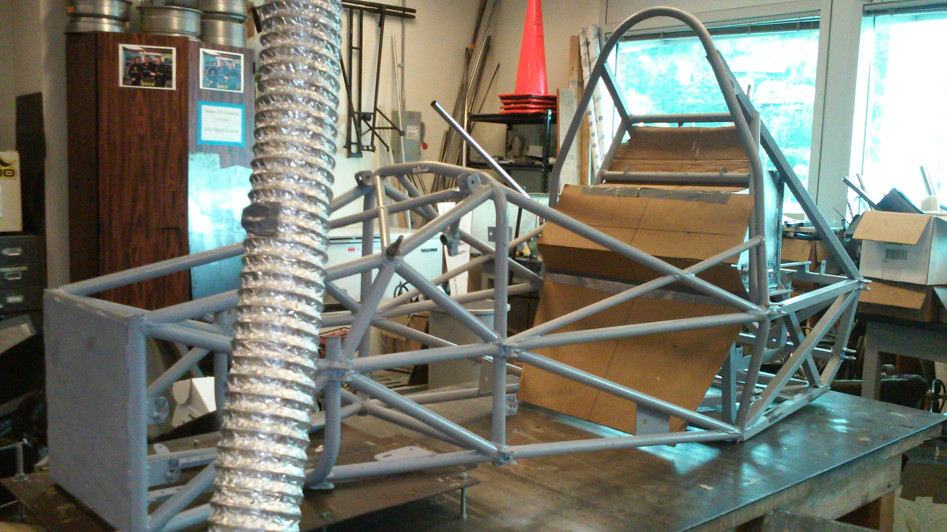
Electric Vehicle Update
In Progress
Currently completely dissembled,
Just got back from paint.
Team seems hopeful that it will be put back together before June.

Slide 6
Goals For The Upcoming Week
System
- Clean up system for presentation
Enclosure
- We will start building enclosure for prototype.
Documentation
- Keep working on report
- Keep working on poster
- Update wiki to fit Michal's wants.
- Create a users manual for the device.
Other
- VMS progress report presentation was moved to a later date.
Notes:
6

